Slide 1
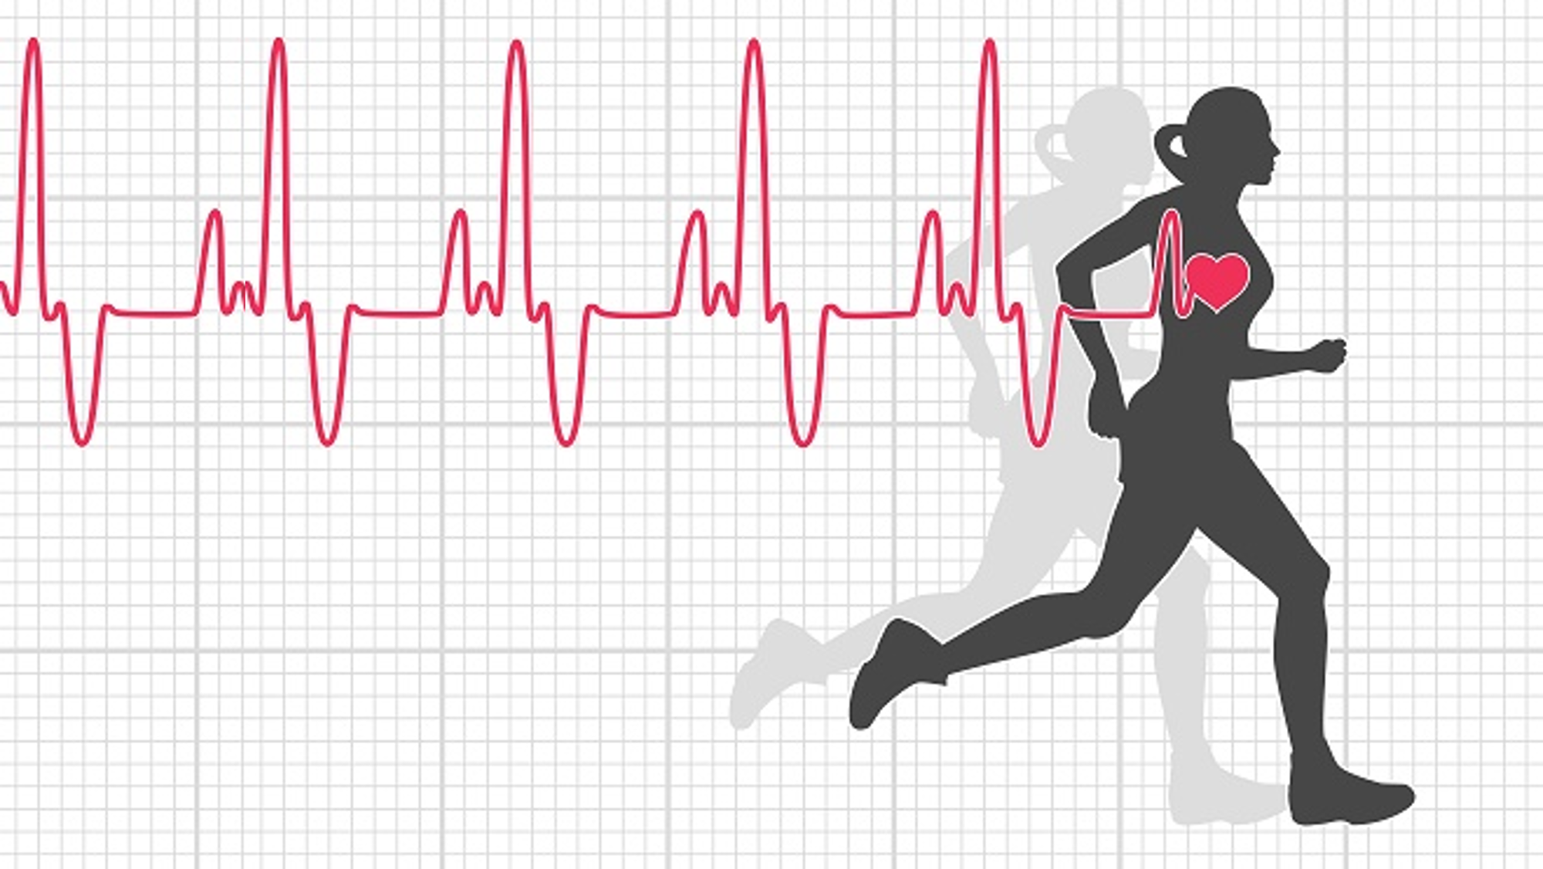
Statistical Analysis Of Diet, Exercise And Fitness
A project report submitted for the partial fulfilment of Semester-I, Programming for Data Science – Big Data Analytics
Under the guidance of Dr. Sudeep Mallick
Submitted By-
Saikat Patra
Ujjwal Chowdhury
Krishnakanta Maity

Slide 2
Introduction
In our day to day life, especially amidst the Covid situation, our diet and our exercise effect our fitness to a very large level which is very important to live a safe & healthy life. Now our main objective behind this study is to analysis how much our diet and exercise effects our fitness.
The study population is young students and target population is our friends. Sample is collected from them.

Slide 3
Objectives
The primary goal of our project is to understand the insight of food consumption, exercise and fitness. The main purpose of EDA is to look at data before making any assumptions. It can help identify obvious errors, as well as better understand patterns within the data, detect outliers or anomalous events, find interesting relations among the variables.
Our approach to measure food habits, fast food composition, physical activity, has greatly motivated our project for understanding of the key determinants and the health problems we currently facing.

Slide 4
Methodology
We collected the primary data for our project using the self-assignment survey method using google forms. Our targeted audience are mostly UG and PG students.
Our questioner is created considering the dietary recommendations of individuals and their behaviour about exercise and fitness. We connected our targeted audience using Social Media and Instant messaging apps. The time frame for which we collect our data is 3 weeks.
Using R and Python visualization part is done.
Used R package – tidyverse
Used python module – matplotlib, seaborn, pandas

Slide 5
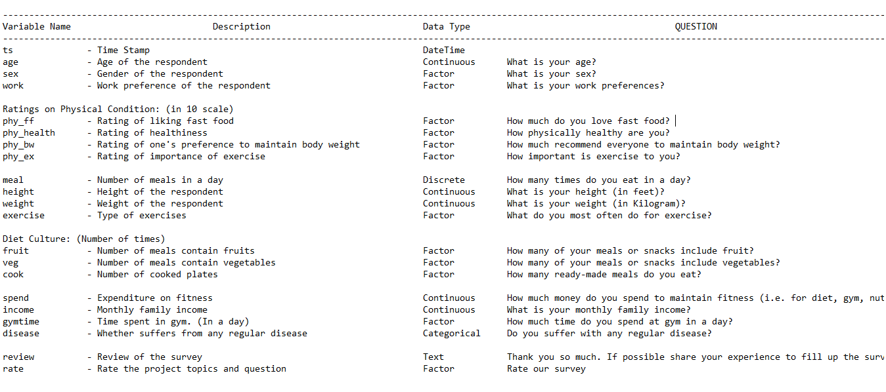
About Data
Source: All data are collected through google forms.
About: This dataset contains 21 variables with timestamps. Description of variables are given below.
Description: Dataset consists 259 observations with the information of the following variables:

Slide 6
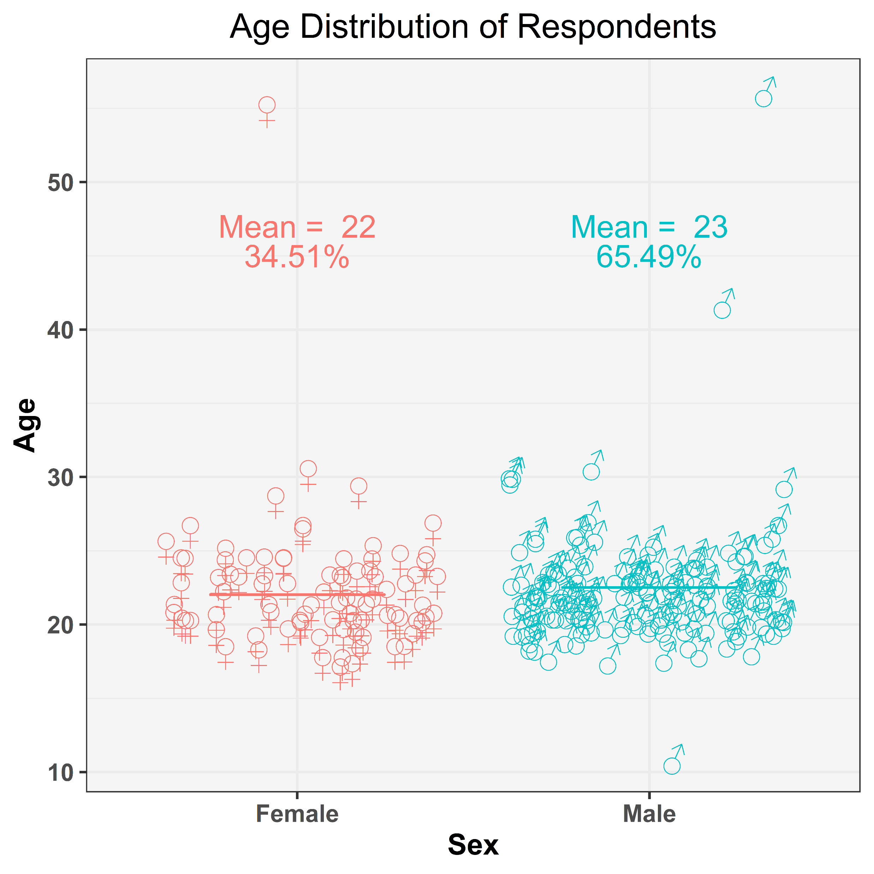

Visualization - 1
65% of respondents are male and 35% of respondents are female.
Almost all are younger (age around 18-23)
Figure – 1: Age distribution of respondents

Slide 7
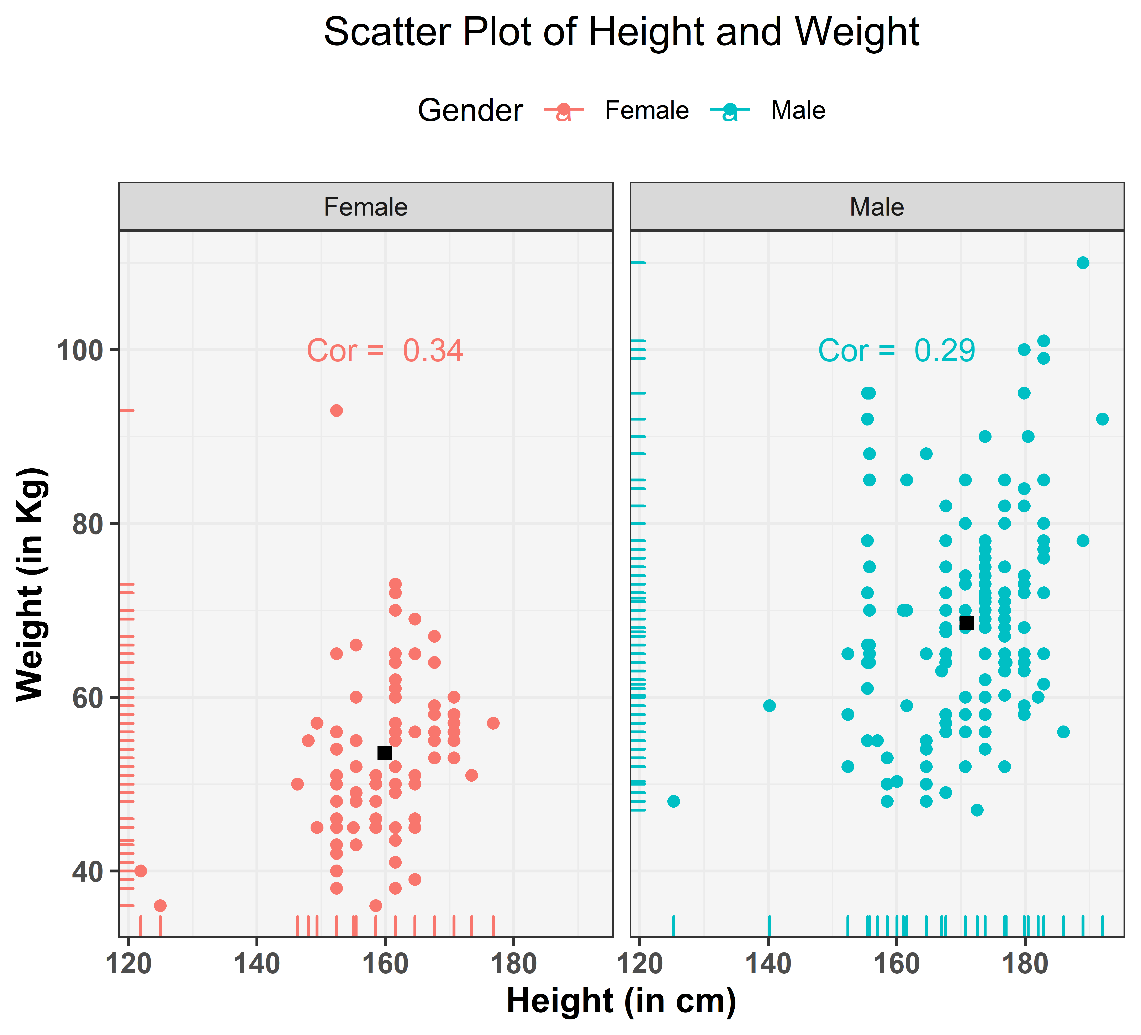
Visualization - 2
Height and weight have more positive correlation in female than male.
Male respondents have more height and weight then females, which is naturally true.
Figure – 2: Gender wise scatter plot of height weight

Slide 8
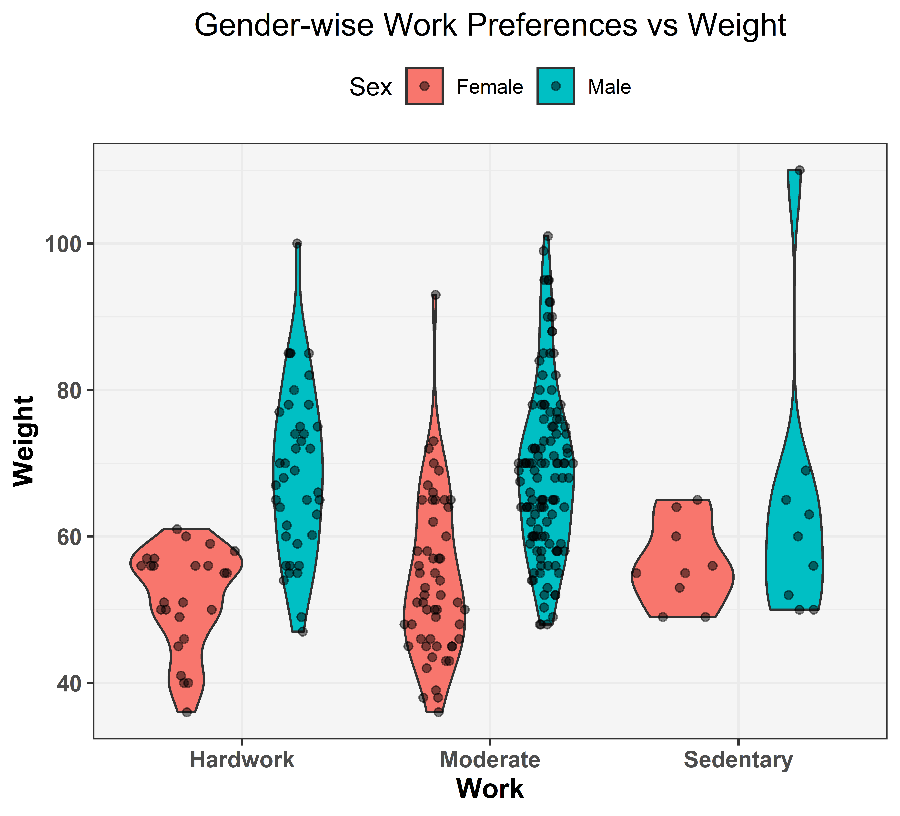
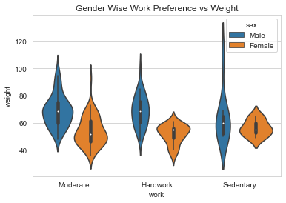
Visualization - 3
Women have lesser weight than their male counter parts in all work preference
Hard working women tend to have lesser weight
Figure – 3.1: Violin plot of weights with their work preference (boxplot imposed)
Figure – 3.1: Violin plot of weights with their work preference

Slide 9
Visualization – 4.1
Allthough
Figure – 4.1: Gender wise distribution of monthly income

Slide 10
Visualization – 4.2
Respondents with good health spend more money in fruits where as lesser healthy respondents spend more on vegetables and cooked foods.
Including fruits in diet can improve overall health.
Figure – 4.2: Diet habit wise distribution of expenditure for fitness

Slide 11
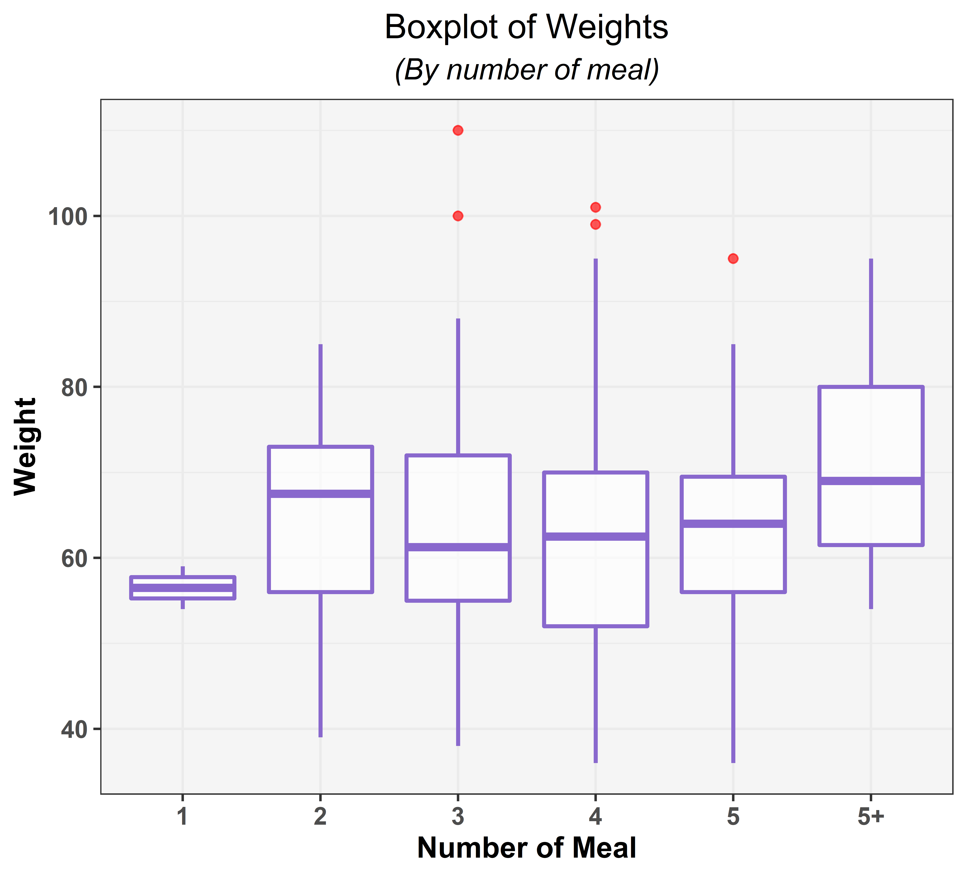
Visualization - 5
There are very few respondents who take only one meal a day , surprisingly the respondents who take 5+ meals per day have almost the same average weight as the respondents who take only 2 meals a day.
Figure – 5: Boxplot of weights

Slide 12
Visualization - 6
Most of the respondents do not spend any money for their fitness.
Distribution of spending money is positively skewed.
Figure – 6: Histogram of expenditure

Slide 13
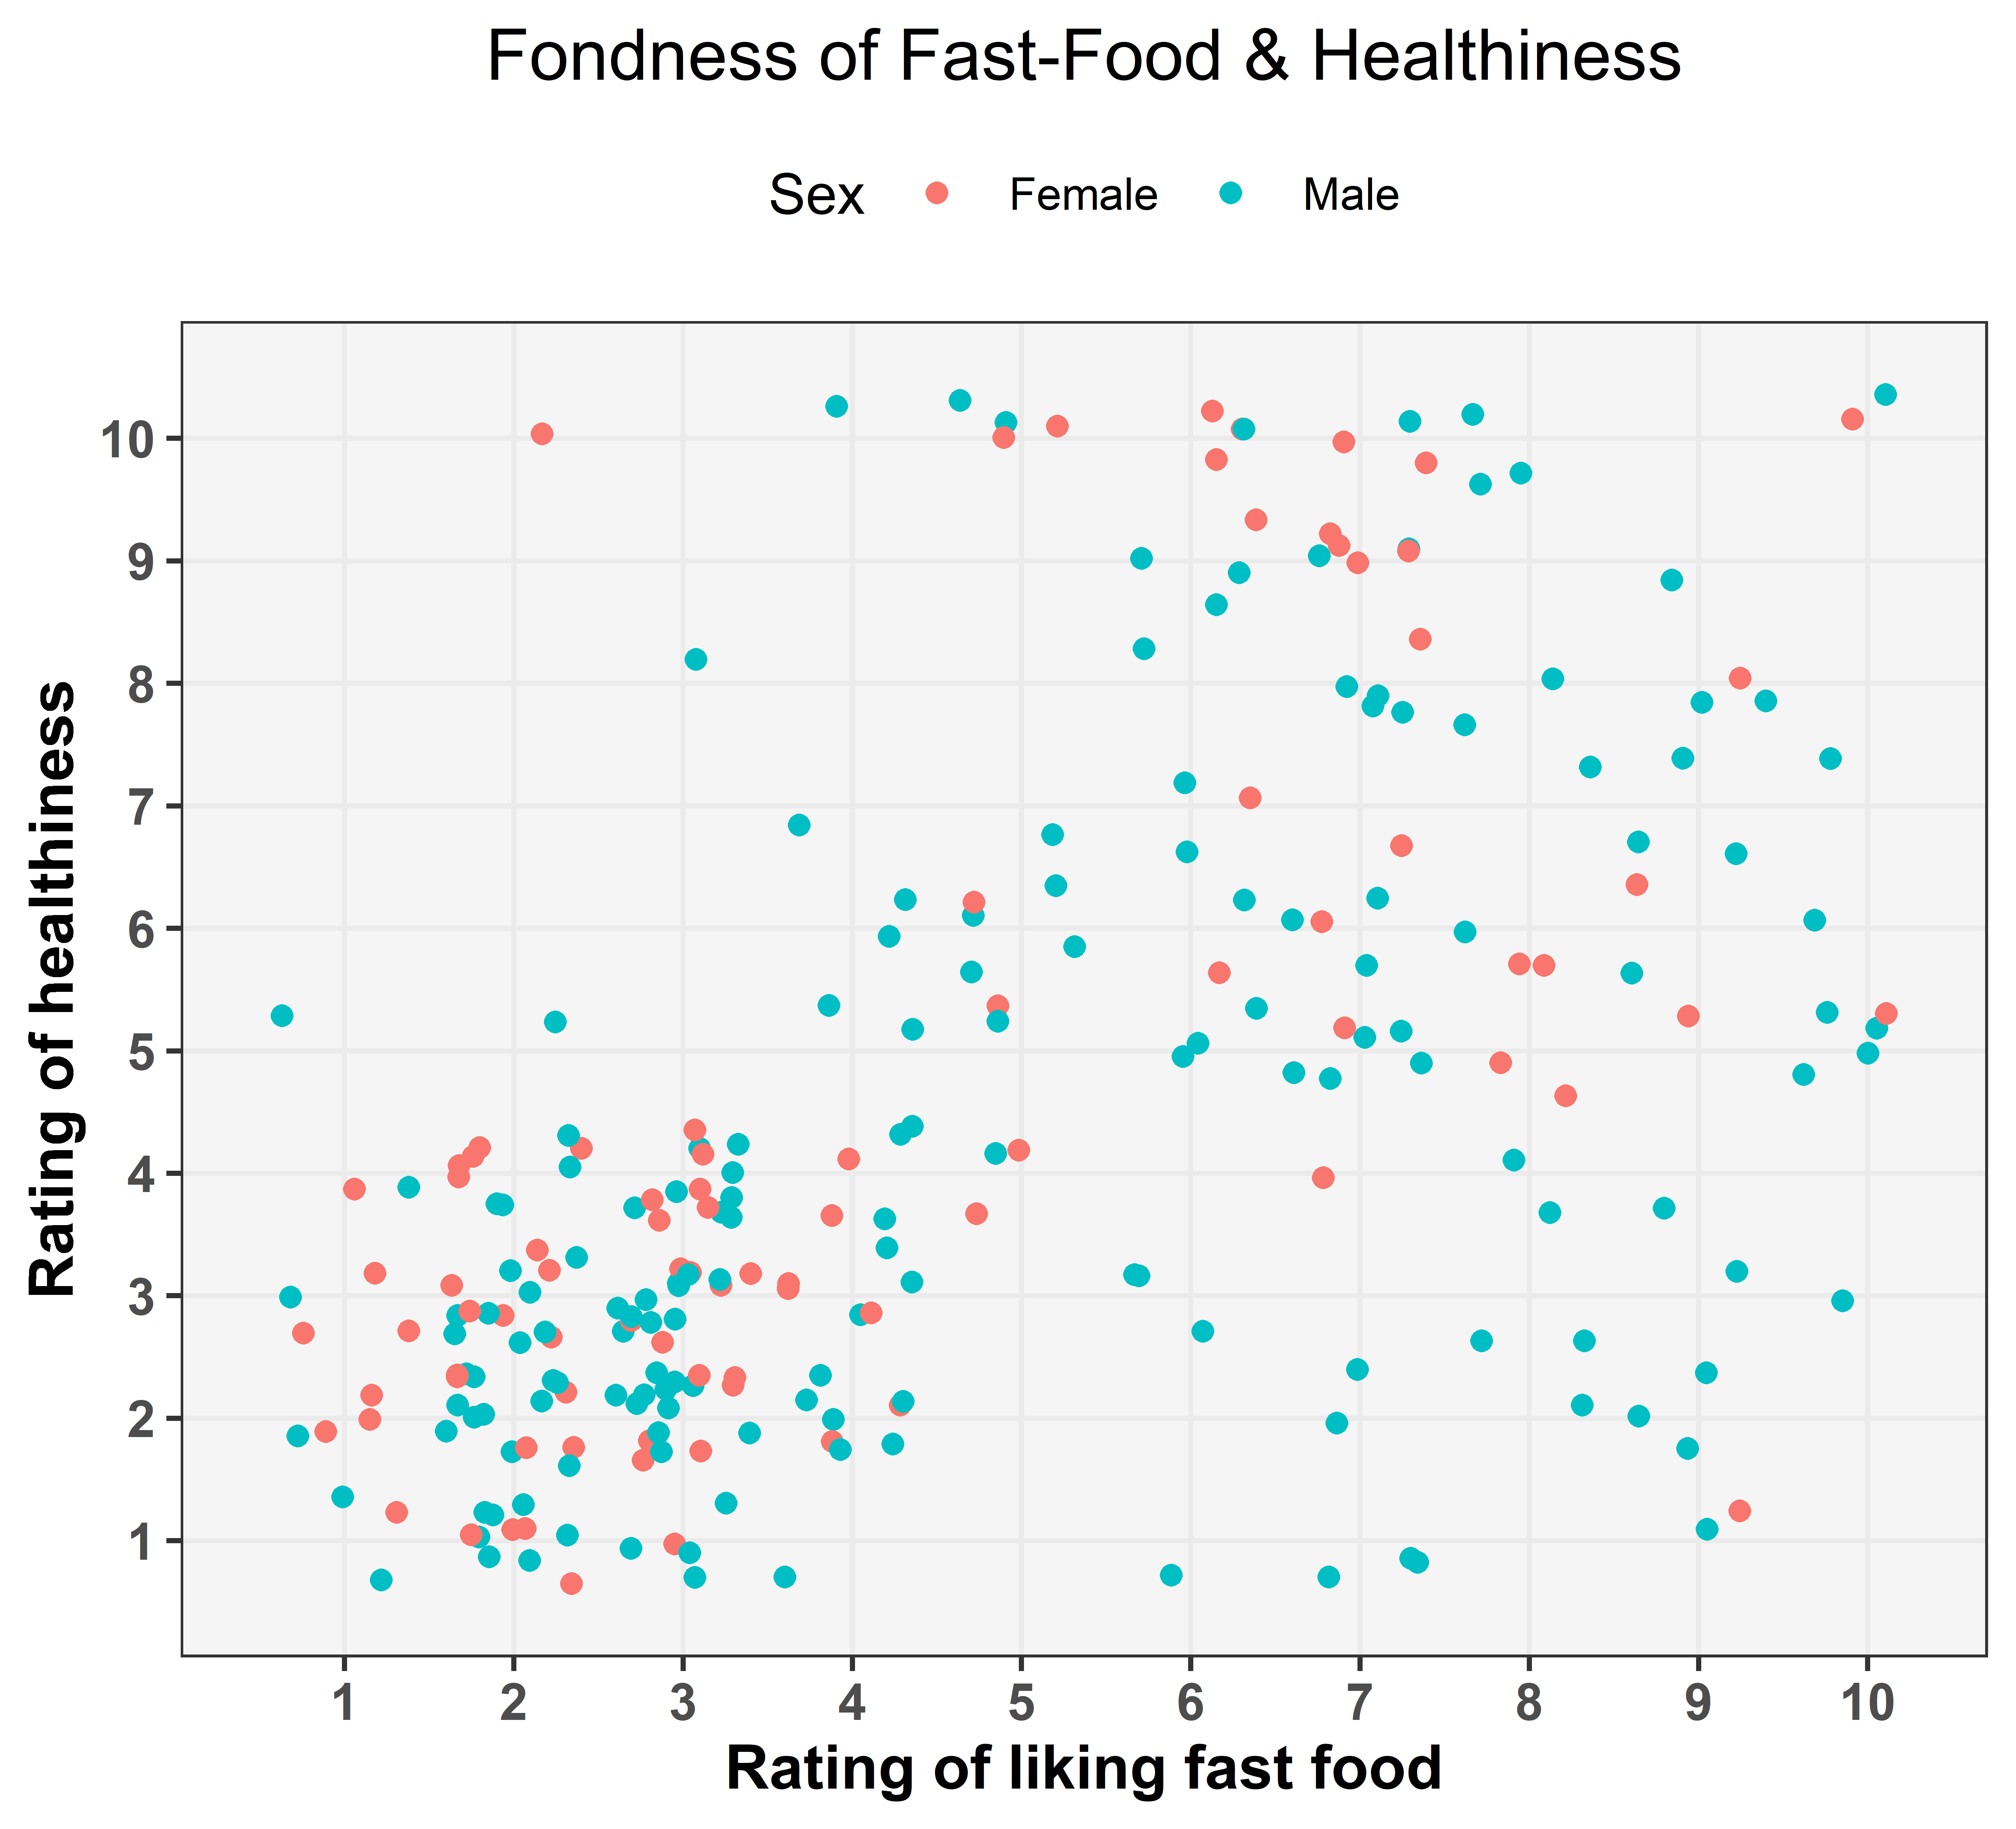
Visualization - 7
There are so many respondents with bad health who don’t like fast food.
Fast food is preferable by healthy persons.
Figure –7: Scatterplot of fondness of fast food and healthiness

Slide 14
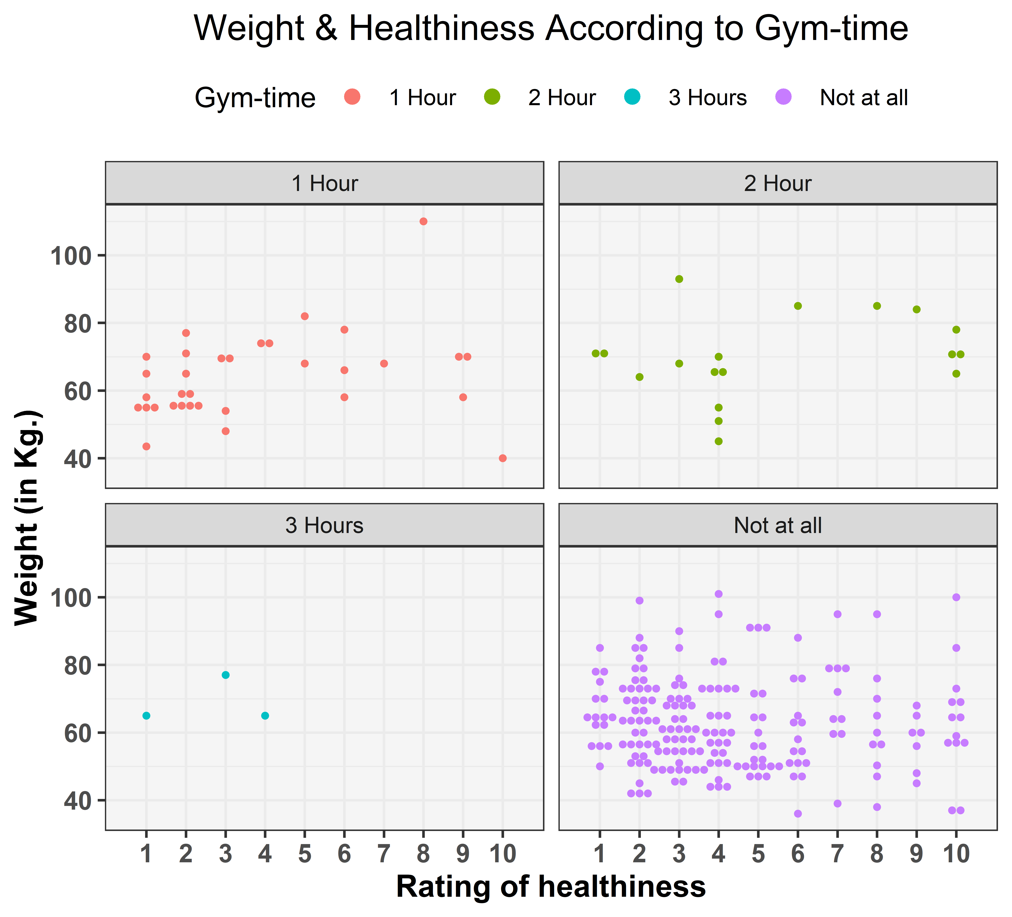
Visualization - 8
People with 3 hours of gym time and no gym time are less healthier than the others.
Figure – 4.1: Gender wise distribution of monthly income

Slide 15
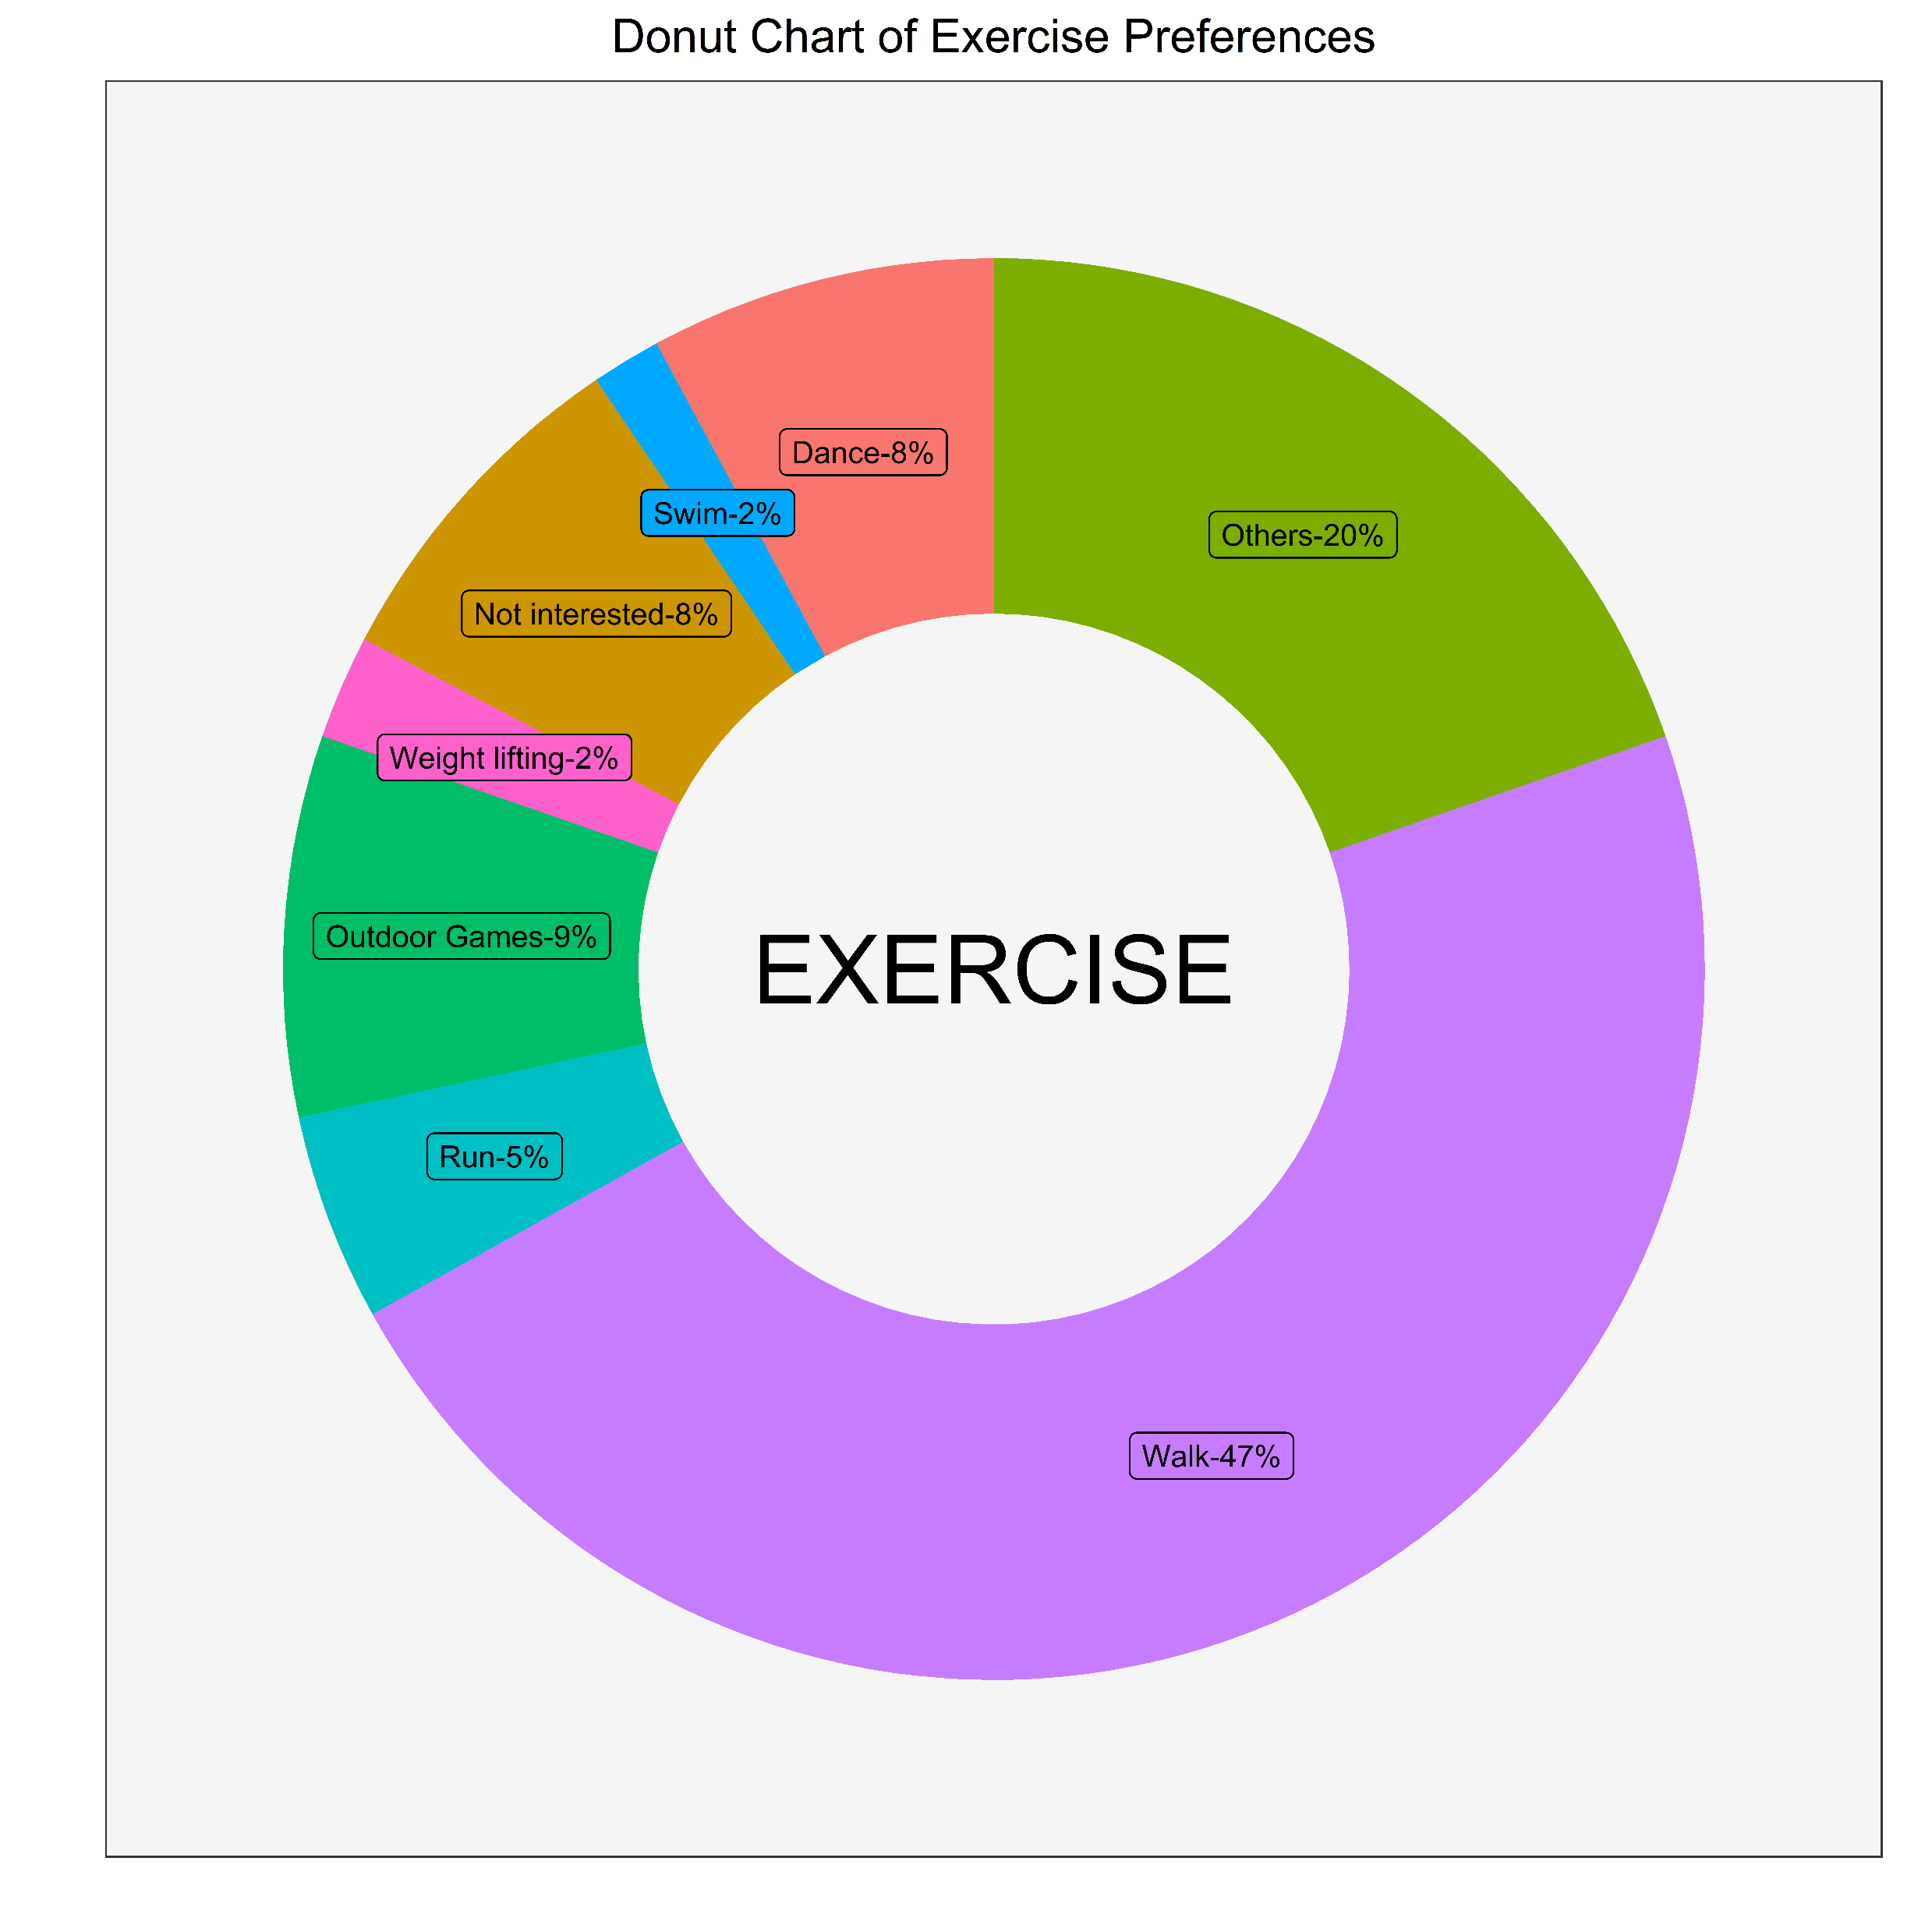
Visualization - 9
Most of the people prefers walk as their primary exercise.
Very small number of respondents have interests in outdoor games, this maybe a psychological ill effect of Covid Lockdown
Figure - 9: Pie-donut chart of exercise preferences

Slide 16
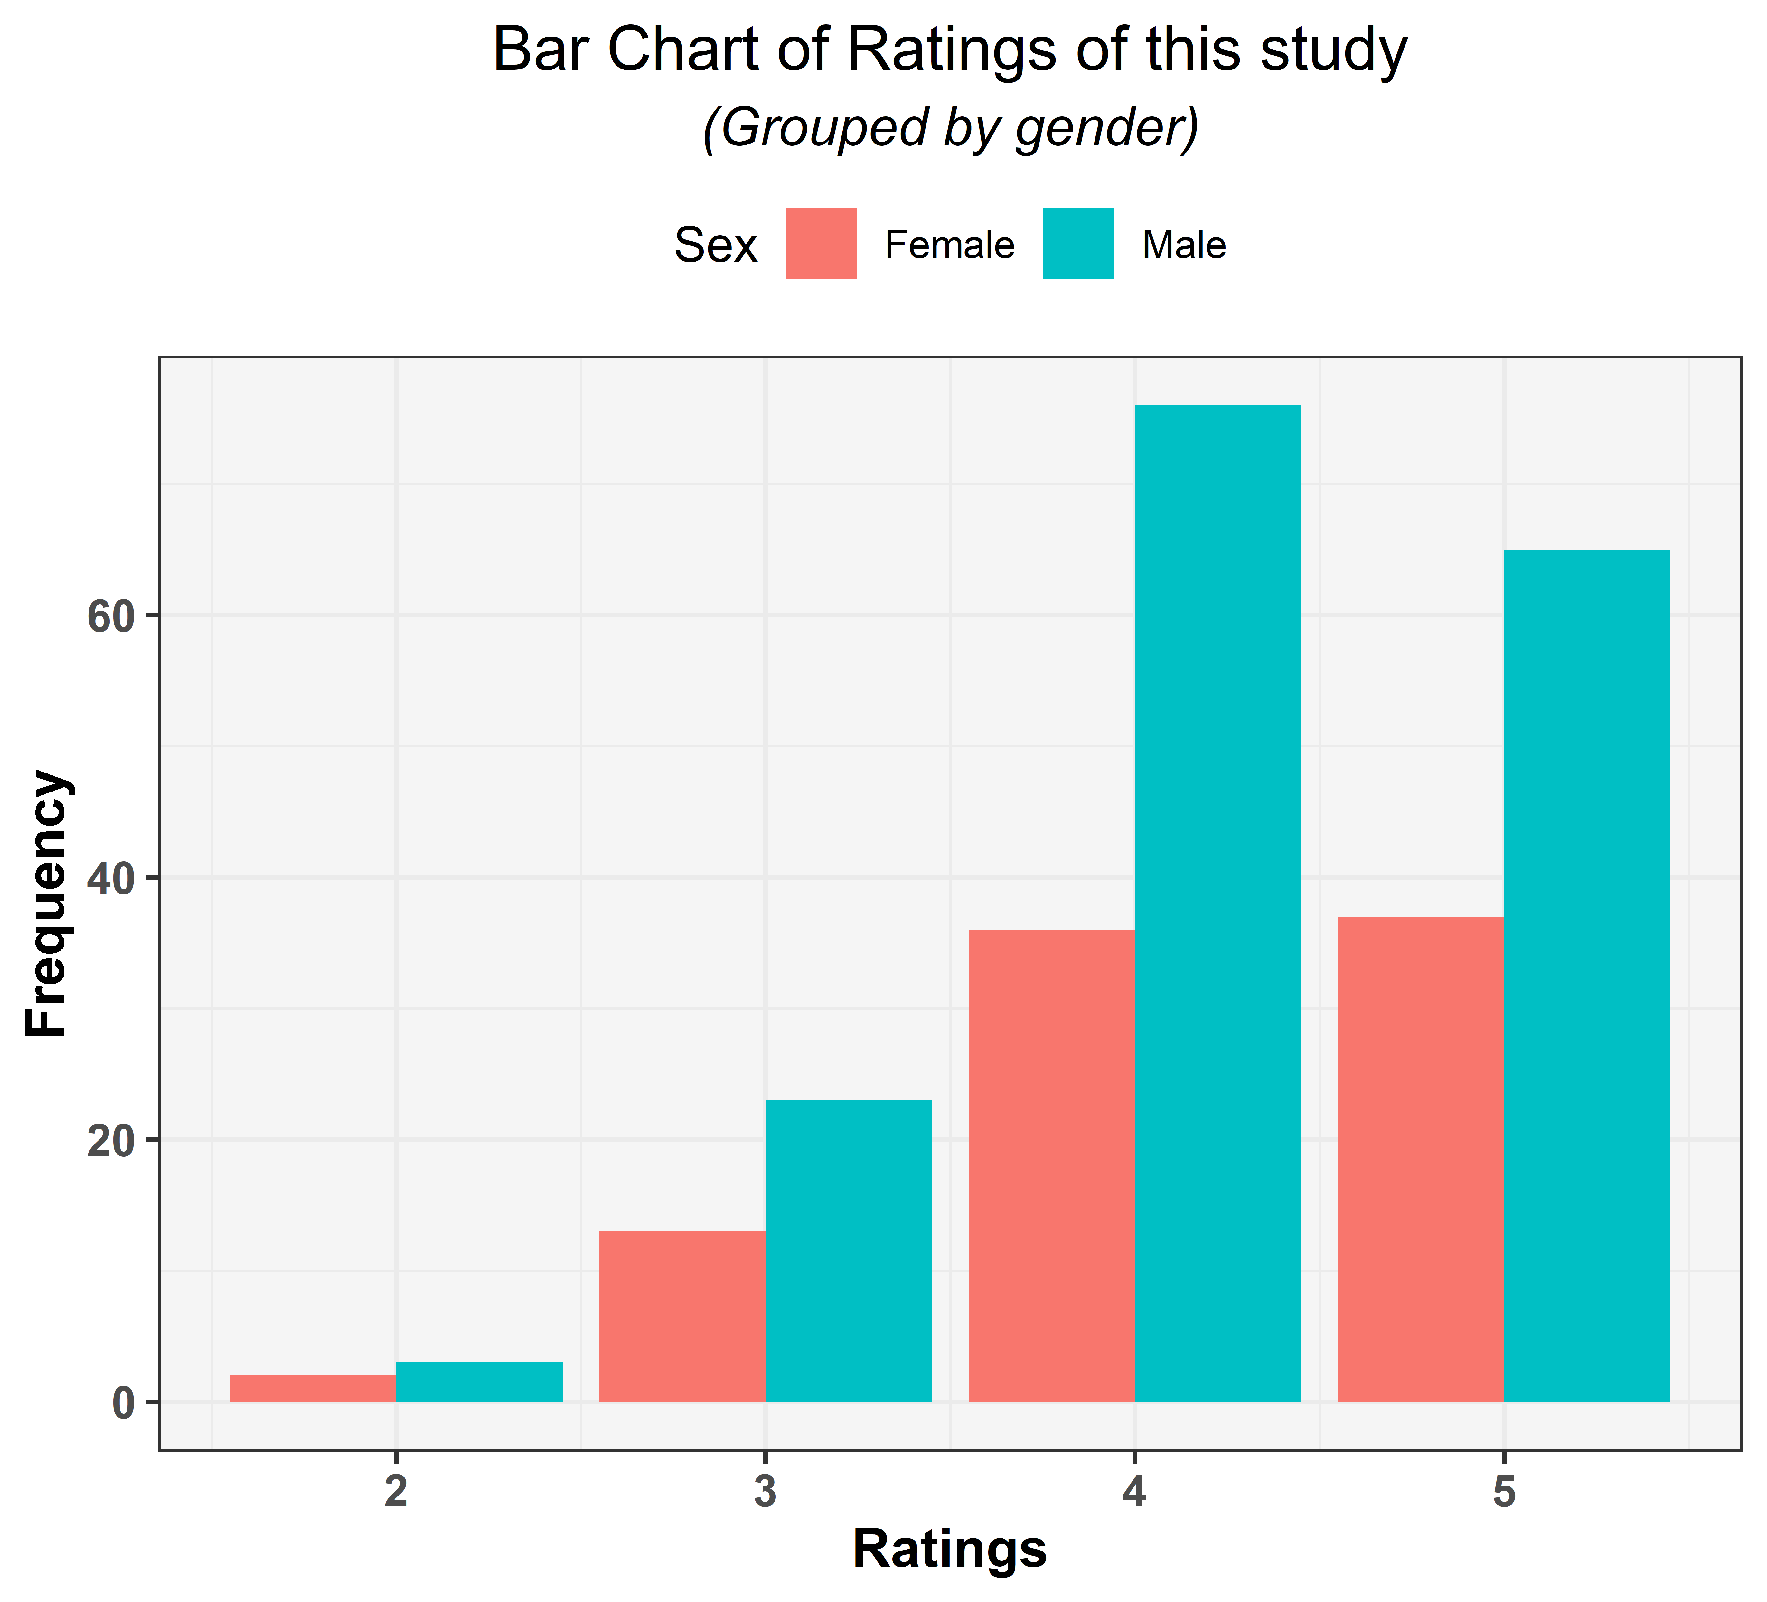
Visualization - 10
No one give 1 star rating.
Almost all gives high rating.
Figure – 10: Bar chart of ratings of the survey

Slide 17
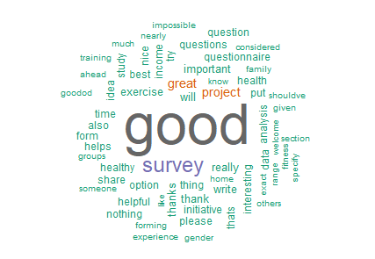
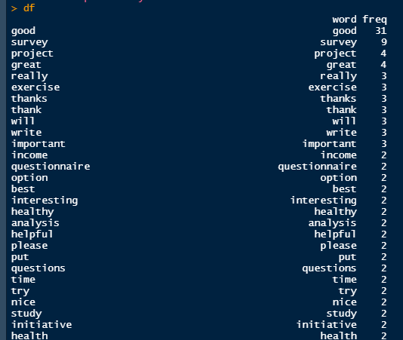
Visualization - 11
Word-cloud suggests that the word “good” has the most frequency among all the words of the review section.
Most of our respondents gave a good review of our survey.
Figure – 11: Word-cloud of reviews
Figure – 12: Snapshot of frequency table of distinct words

Slide 18

Conclusion
The lockdown to contain the spread of COVID-19 had a huge impact on health care , diet and people’s exercise habits.
The asymptomatic nature of the disease and isolation increases the fear and anxiety which leads in decrease in Gym time and outdoor games . So they prefer walking as exercise. Reduced expenditure in fitness also indicates this.

Slide 19
Limitations
Our data set involves a smaller sample, hence the results cannot be accurately interpreted for a generalized population. Most of the inferences are focus on quantitative data that leads to some outliers. Our targeted audiences are mostly around the age 23, so there are some judgmental bias.
Not giving respondents enough options to respond properly as per their choice of others. We should have given a textual input to users so that they could have mentioned if their preferred options was not one of the choices provided by us.

Slide 20
Thank You

